Slide 1


Mini Project
Rajat Rout
121EE0777

Slide 2

Mini Project
This is a GUI program that collects data from the open circuit and short circuit tests and prints the values of the equivalent circuit parameters and draws the schematic circuit diagram of the transformer with parameter values.

Slide 3

GUI
GUI is the acronym for graphical user interface—the interface that allows users to interact with electronic devices through graphical elements. It’s a valuable part of software application programming in regard to human-computer interaction, replacing text-based commands with user-friendly actions. Its goal is to present the user with easy-to-find, understand, and use decision points. GUI uses visual elements to represent those now hidden lines of command. You simply select a button or an icon to call the relevant function. The easy use of GUIs has made it possible for the public in general, regardless of experience or knowledge, to access all kinds of systems for everyday use.

Slide 4
Python GUI Programming With Tkinter
Python has a lot of GUI frameworks, but Tkinter is the only framework that’s built into the Python standard library. Tkinter has several strengths. It’s cross-platform, so the same code works on Windows, macOS, and Linux. Visual elements are rendered using native operating system elements, so applications built with Tkinter look like they belong on the platform where they’re run.
Tkinter is lightweight and relatively easy to use compared to other frameworks. This makes it a compelling choice for building GUI applications in Python, especially for applications where a modern sheen is unnecessary, and the top priority is to quickly build something that’s functional and cross-platform.

Slide 5
In order to work with a tkinter application, we have to install and import the tkinter library in our environment. Generally, we import the tkinter library in the environment by using from tkinter import * command.
main_window=Tk(), Tk applications (which have windows associated with them) create one or more MainWindows which act as the containers and parents of the other widgets.
The foundational element of a Tkinter GUI is the window. Windows are the containers in which all other GUI elements live. These other GUI elements, such as text boxes, labels, and buttons, are known as widgets. Widgets are contained inside of windows.

Slide 6
After that, I assigned the variables, the main window title, and the main window geometry size. I created an icon using FAVICON(website) for this GUI and gave the main window icon. Then I gave the background image and set its path for the main window. Using the text and text variable functions used in the main window. Used the string operator to specify the string values and then specified the label's font and placement coordinates. def openNewWindow(): used this to open a new window, set its title and geometry size. Then I assigned the formula to calculate the values of the equivalent circuit parameters.

Slide 7
Formula used
A = ocpower/(ocvolt*occurrent)
where a is power factor at open circuit condition and is cos component of the angle.
Core loss = ocvolt/(occurrent*a)
b=(1-a**2)**(0.5)
where b is the sin component of the angle
magnetising Reactance=ocvolt/(occurrent*b)
Impedance = shvolt/shcurrent
Equivalent Resistance = shpower/(shcurrent^2)
EquivalentReactance = ((impedance^2)-(EquivalentResistance^2))^(0.5)

Slide 8
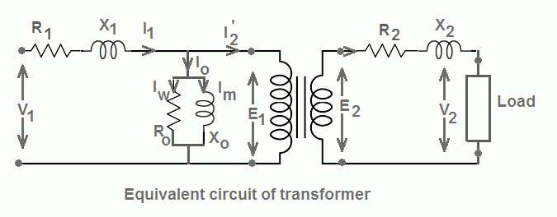

Slide 9
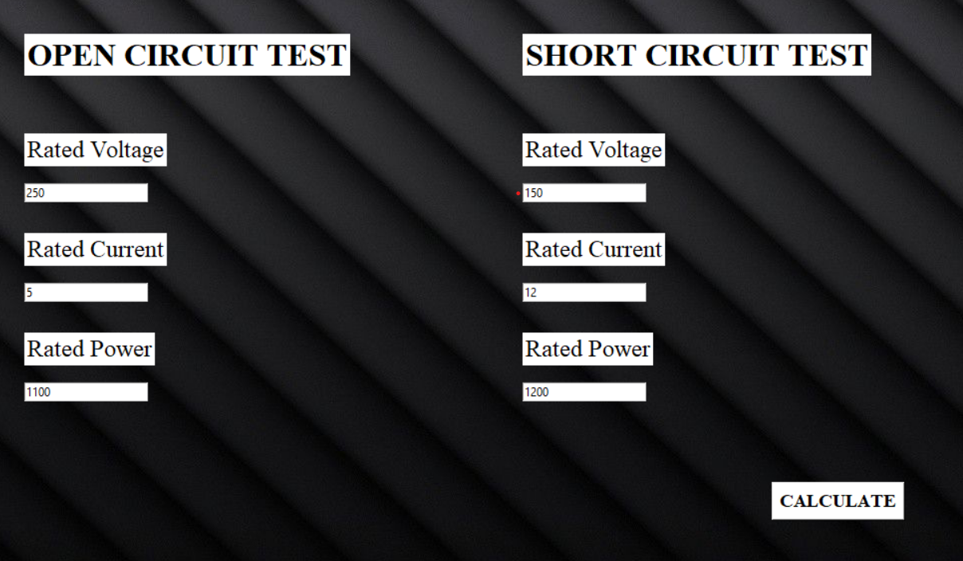
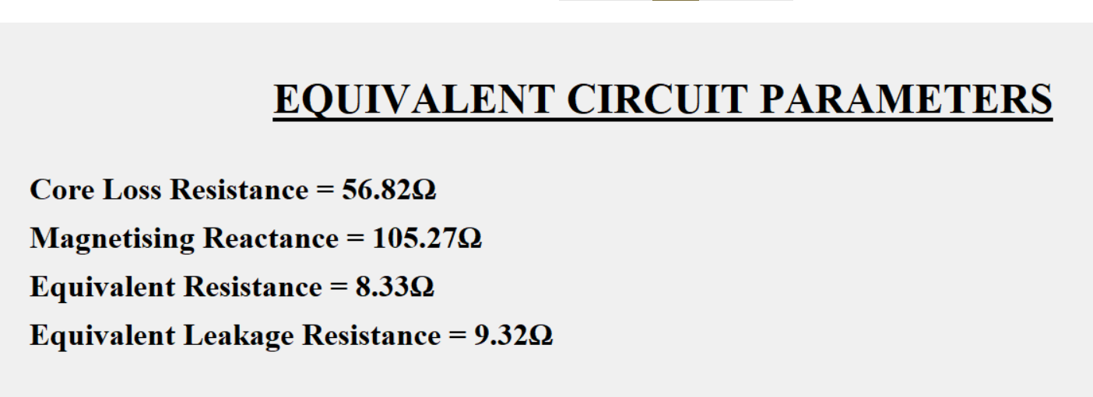
Flow chart
Main Window
Result Window
After clicking on the .exe file, we get to the main window where we will take the users’s input values of the rated, voltage, current and power for the open and short circuit tests.
This result window gives the final equivalent circuit parameters for the input from the user
After clicking on calculate we are taken to a new window; the results window.

Slide 10

THANKS!

